Slide 1
TITLE: Collaborative Learning Portal TEAM NAME: TEAM ILISH
Name | Entry No
USHNEESH CHATTOPADHYAY MOU SAHA SOUMYADEEP DAS PRASANTA PAUL | 2025CSM1016 2025CSM1017 2025CSM1014 2025CSM1019

Slide 2
Project Overview
It’s going to be an online platform designed to support interactive and group-based learning. It will allow students and instructors to share study materials, participate in discussions, work on projects together, and track learning progress also additional features like Heatmaps, Learning path, Study Group/resource sharing, and Real-time Doubt Polls – post a doubt, and peers can upvote the best explanation. It can have features like taking and giving quizzes, attendance system and as well as a progress tracker of a defined subject .Built for reliability, collaboration, and extensibility. Modular, containerized deployment using Docker.
Problem Statement & Goals
Need for a robust, extensible platform for group learning
Key goals:
Enhance collaboration
Easy resource sharing
Real-time communication
Transparent manual analytics
Simple deployment and scaling

Slide 3
Key Features/tOOLS
FEATURES Study material sharing Study Room Doubt Polls- Upvote and final answer Collaborative project spaces Quiz management (creation, grading) Attendance system (QR/manual) Progress tracker (manual milestone/subject tracking) Visual heatmaps | Technical Stack & Tools Design: Figma Frontend: HTML/CSS/JS, Flutter Backend: Node.js Database: MySQL Containerization: Docker for all components

Slide 4
Workflow
Requirement gathering (user roles & features)
UI/UX design and prototyping
Develop backend, frontend, and real-time modules
Write Docker file for each component
Link services with docker-compose.yml
Local dev using containers (rapid onboarding)
CI/CD pipelines for building, testing, and deployment
Production: scale, update, or rollback containers as needed

Slide 5
Existing Collaborative Learning Apps
App Name | Key Features
Learn Together | Virtual classrooms, group discussions, real-time project work
Google Classroom | Assignment management, announcements, class discussions
Formative | Custom quizzes/assessments, real-time feedback, integration with Google

Slide 6
Key Differences: Existing Model vs Approached Model
Criteria | Existing Collaborative Apps | Approached Model (Your Portal)
Analytics & Tracking | Often automated, AI/ML-powered dashboards and insights. | 100% manual, rule-based analytics and dashboards—no ML/AI is used; explicit logic and visible progress tracking
Collaboration Tools | Standard features: real-time chat, group file sharing, peer review; some platforms add automated project matchmaking | Feature-rich: chat forums, Visual heatmaps, Learning path, Study Group/resource sharing, and Real-time Doubt Polls, collaborative projects, attendance, manual peer review, modular group management; all based on user actions—not algorithmic matching
Deployment & Setup | Deployed via web or app stores; setup process can vary or be complex | Fully Dockerized: one-click developer onboarding, modular cloud/on-prem deployment; easier scaling, maintenance, and upgrades
Reliability/Consistency | Dependent on underlying device setups, sometimes inconsistent across platforms | Guaranteed consistency and isolation via Docker containers; identical environments for all users, simple troubleshooting

Slide 7
Targets
Week-01
UI/UX Design
Logo Design
Schema Design
Week-02 & 03
Task Division
Backend Development
Database building using MySQL
Connection with database
Week-03 & 04
Frontend Development
Integrate login, dashboard and course module
Connect backend
Week-05
Dockerization
Debugging/Testing

Slide 8

Logo Design

Slide 9
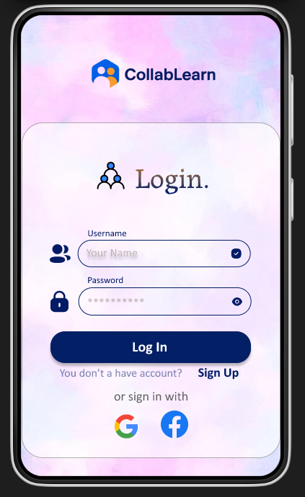
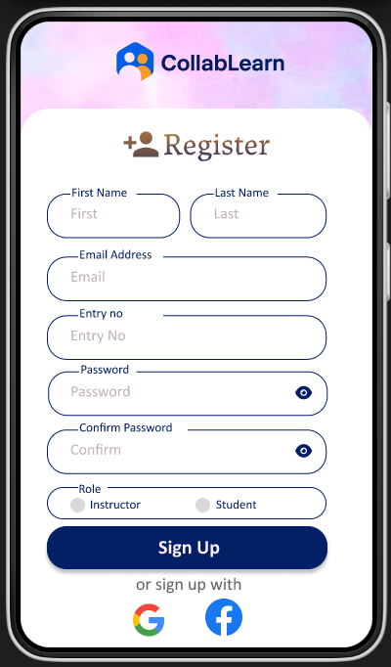
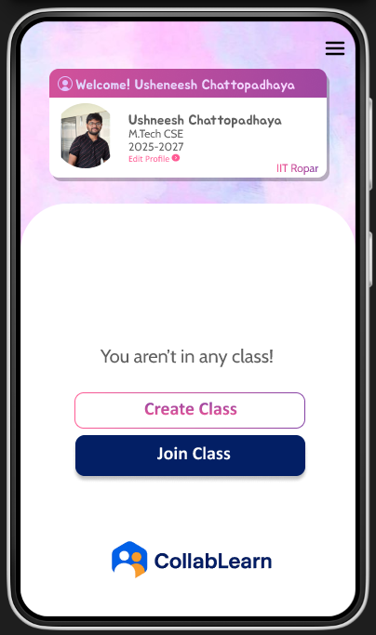
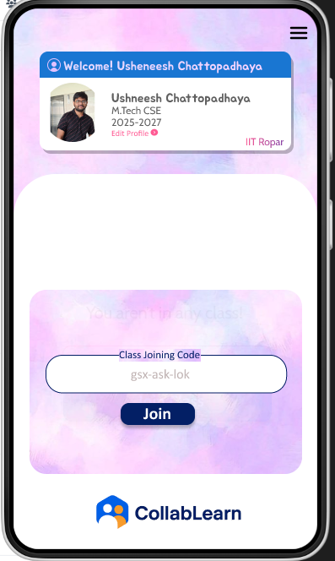
UI-User Interface Design
Tool used- Figma

Slide 10
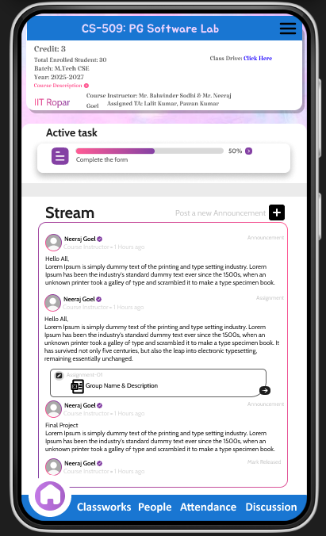
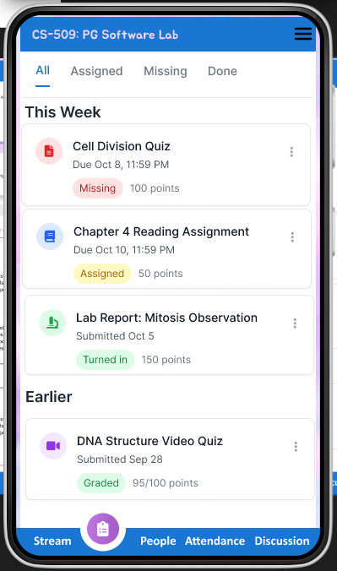
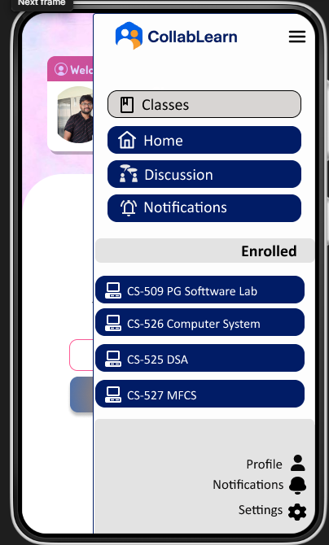
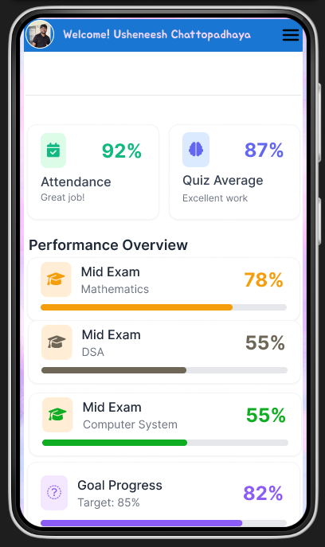
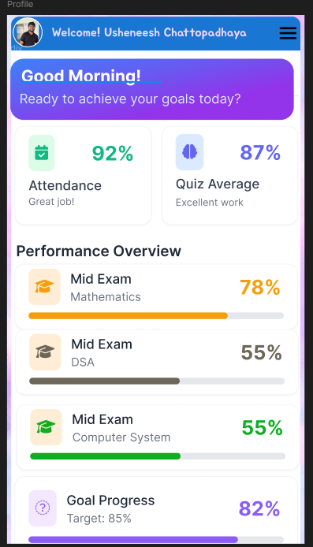
UI-User Interface Design cont.
Tool used- Figma

Slide 11
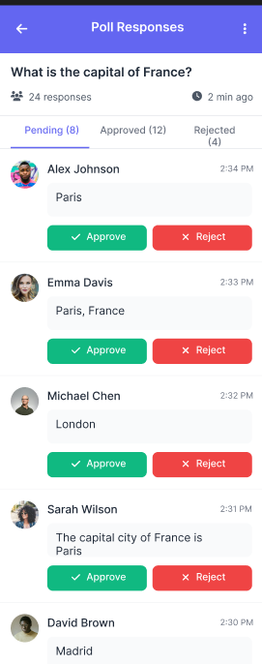
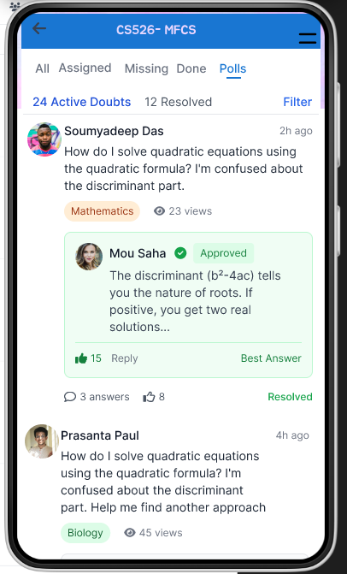
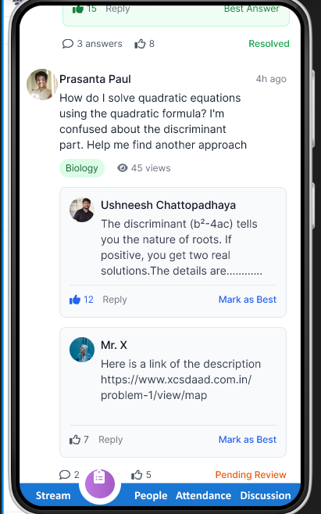
UI-User Interface Design cont.
Tool used- Figma

Slide 12
Backend-database schema overview(intended)
Users
user_id (pk)
name
email
password_hash
role-(std/tech)
joined_on
Progress Tracker
progress_id (PK)
student_id (FK)
course_id (FK)
milestone
percentage
Study Materials
material_id (PK)
course_id (FK)
uploader_id (FK)
description
created_on
ActivityLog
log_id (PK)
user_id (FK)
course_id (FK)
activity_type
activity_time
Courses
course_id (PK)
Instructor_id (FK)
course_name
description
created_on
Doubt Polls
poll_id (PK)
course_id (FK)
posted_by (FK)
question
created_on
Quizes
quiz_id (PK)
course_id (FK)
created_by (FK)
title
total_marks

